Slide 1


Slide 2
Construction Leadership
On-Site Project Management

Slide 3
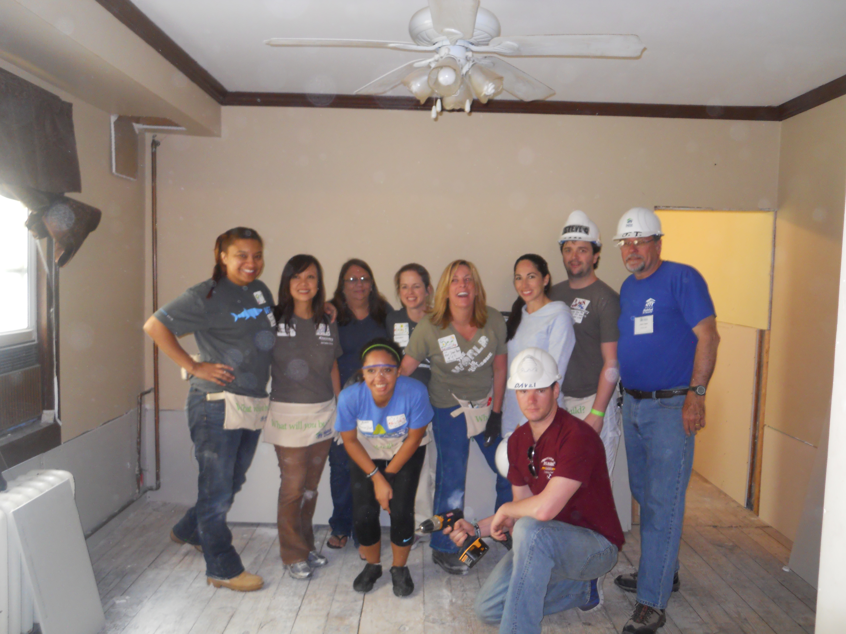
Everyone
On a Habitat build site deserves a fun, safe and rewarding time.

Slide 4
Experience
How long have you been leading Habitat job sites?
What is your biggest challenge?
Do you usually get the right number and skill of volunteers?
I know! I did it for 10 years!
What would you most like to learn today?

Slide 5
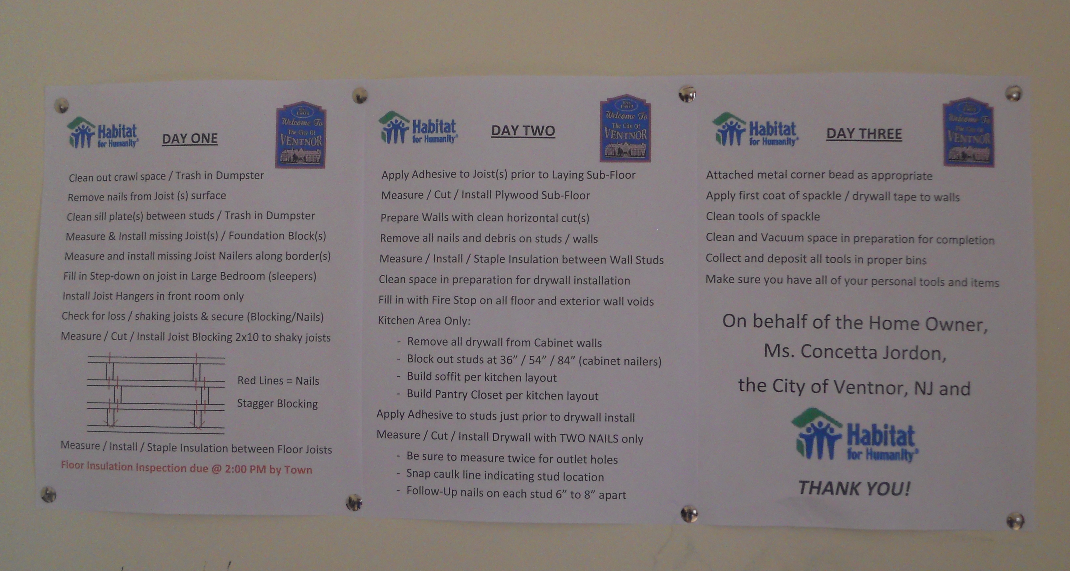
Planning
Schedule
Tasks
  Breakdown of tasks
    Contingency tasks
Volunteers
  Desired
    Needed
Materials
Tools

Slide 6
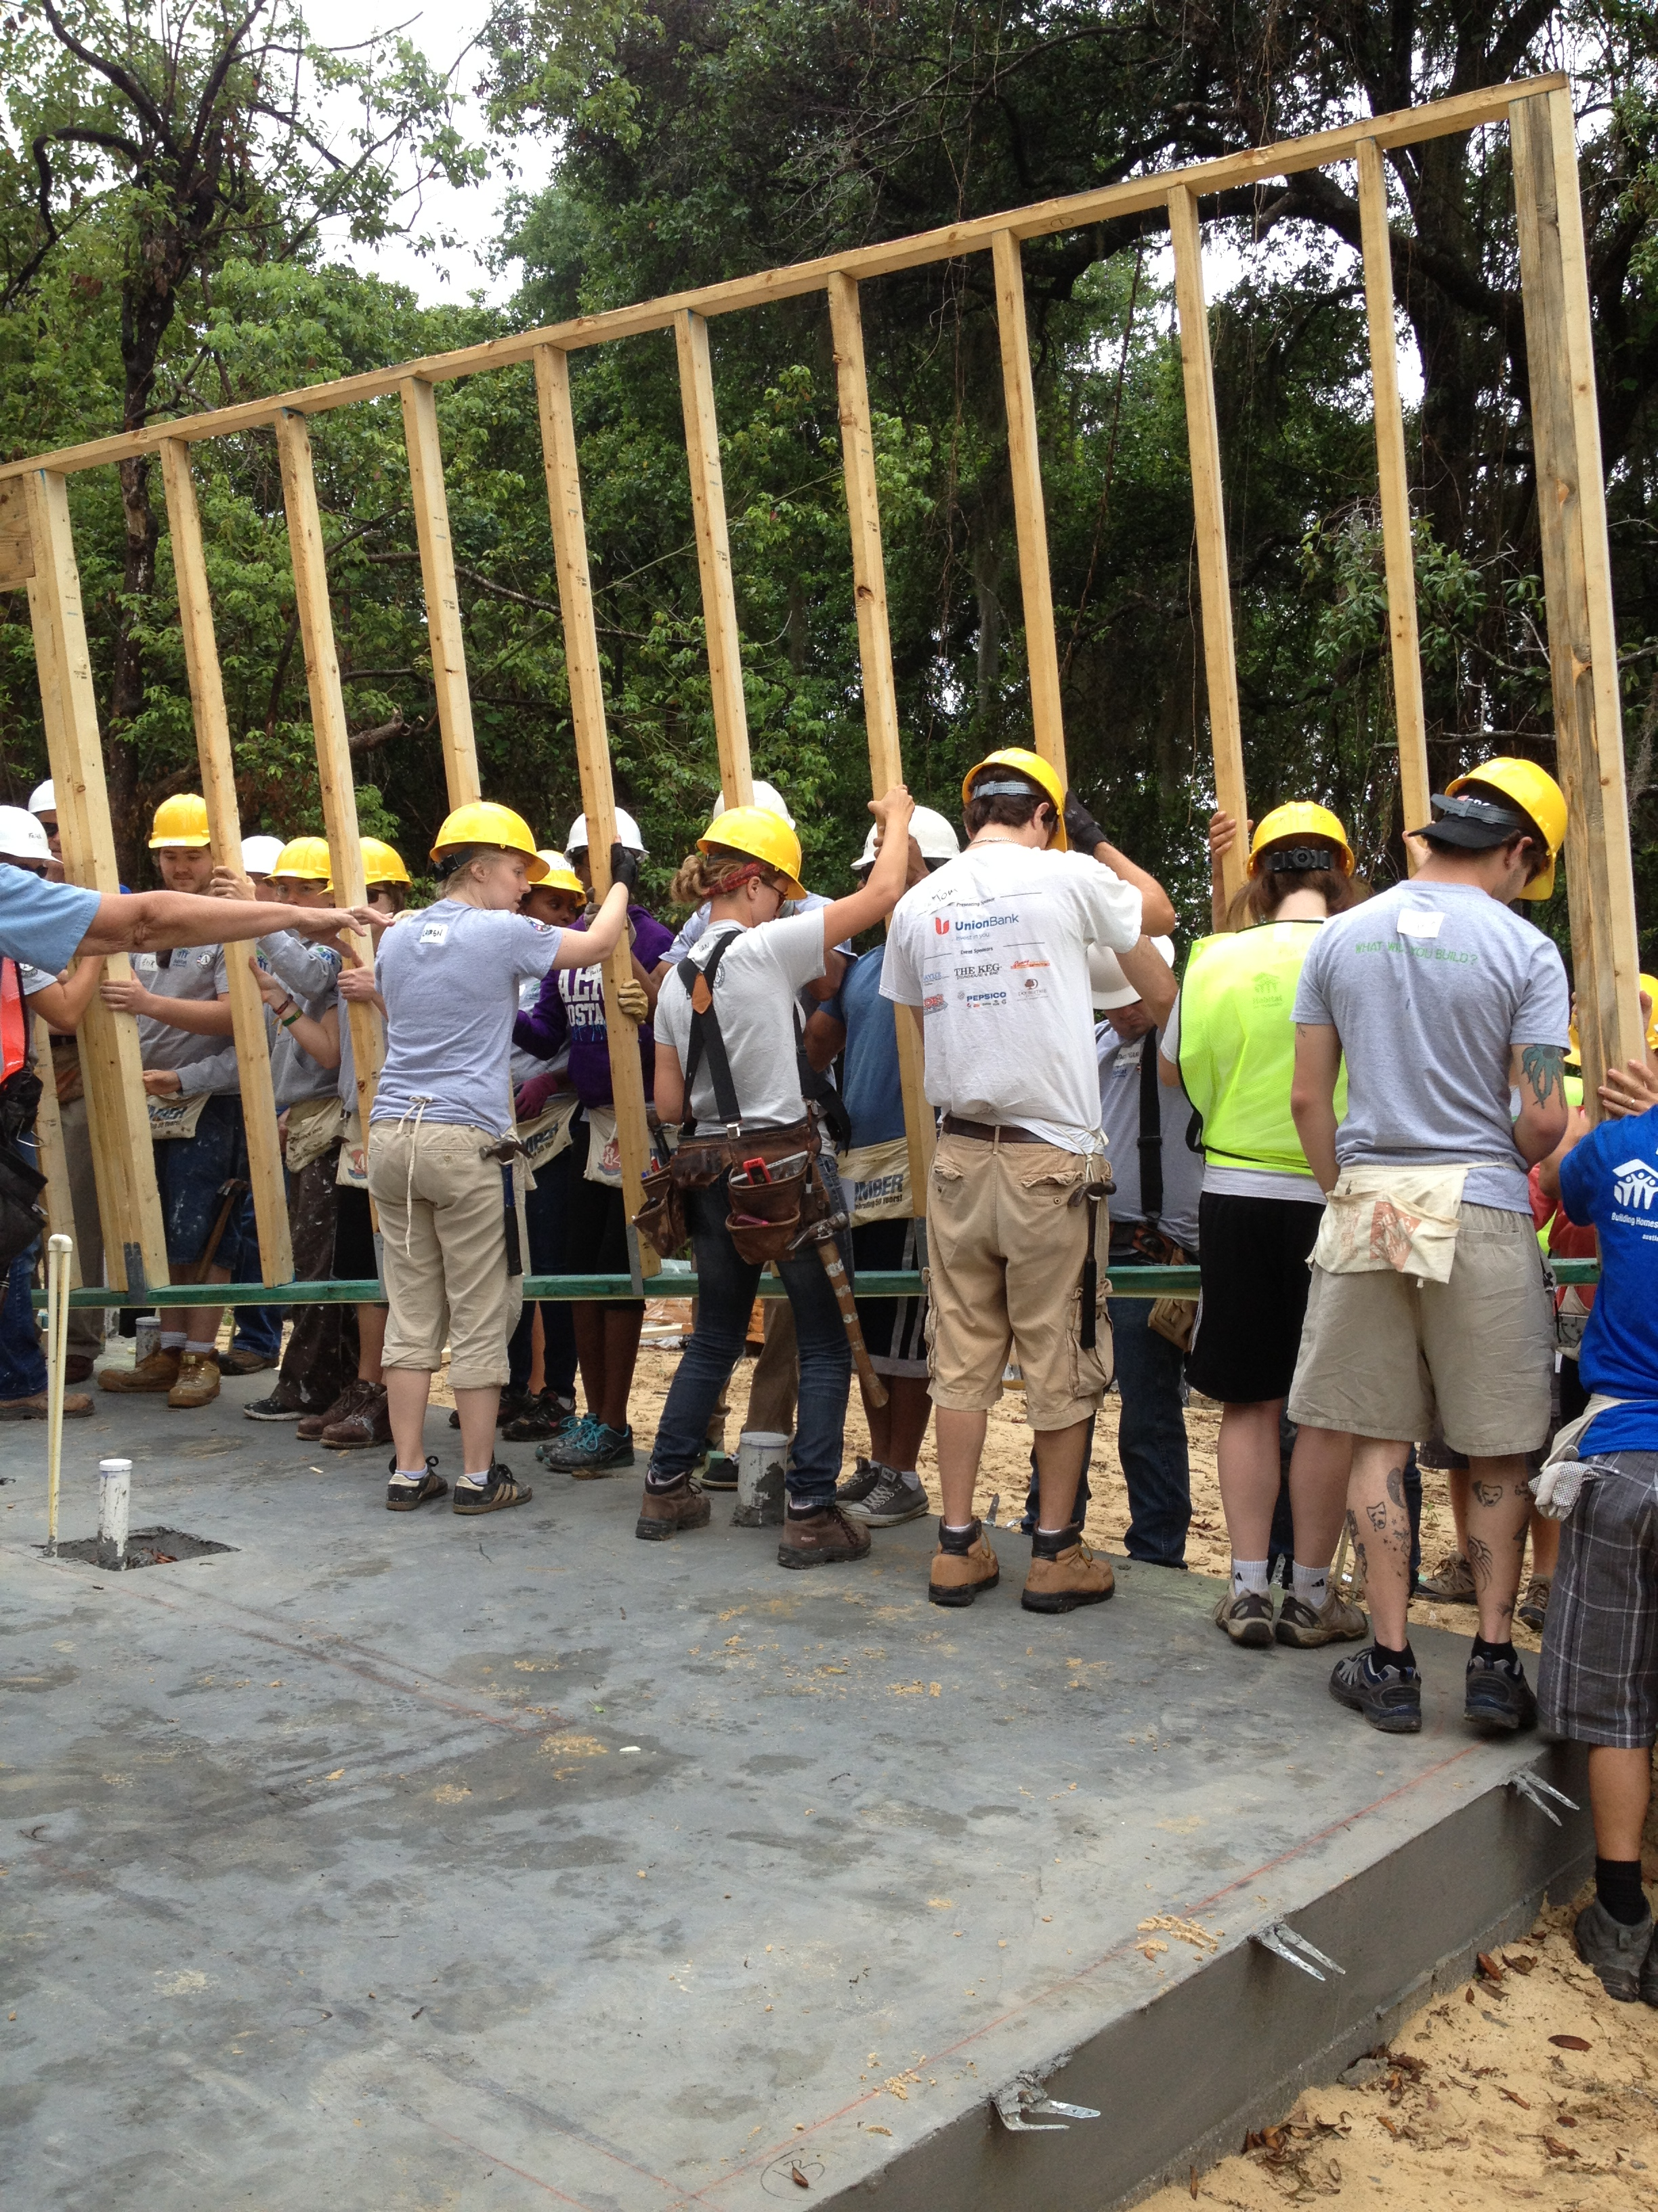
Volunteers are our Guests
Like Dinner Guests
  Set the table
    Planned activity
    Materials
    Tools
    PPE
    Leadership
Habitat is Grassroots
  Relationships
  Families
  Funding
  More Volunteers

Slide 7
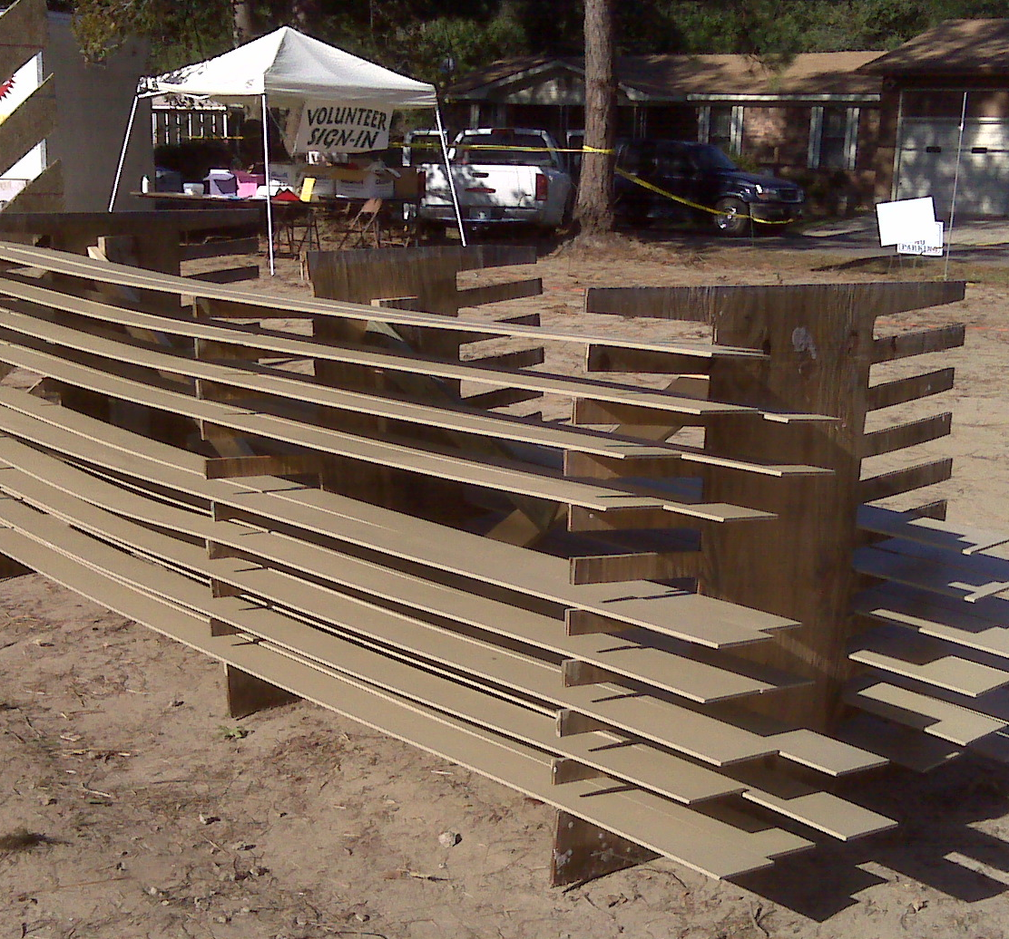
Start with an Organized Site
Manned sign-in tent
- First-aid
- Water & break area
Tools trailer
Materials
Trash and Recycling
Lunch Area
Parking

Slide 8
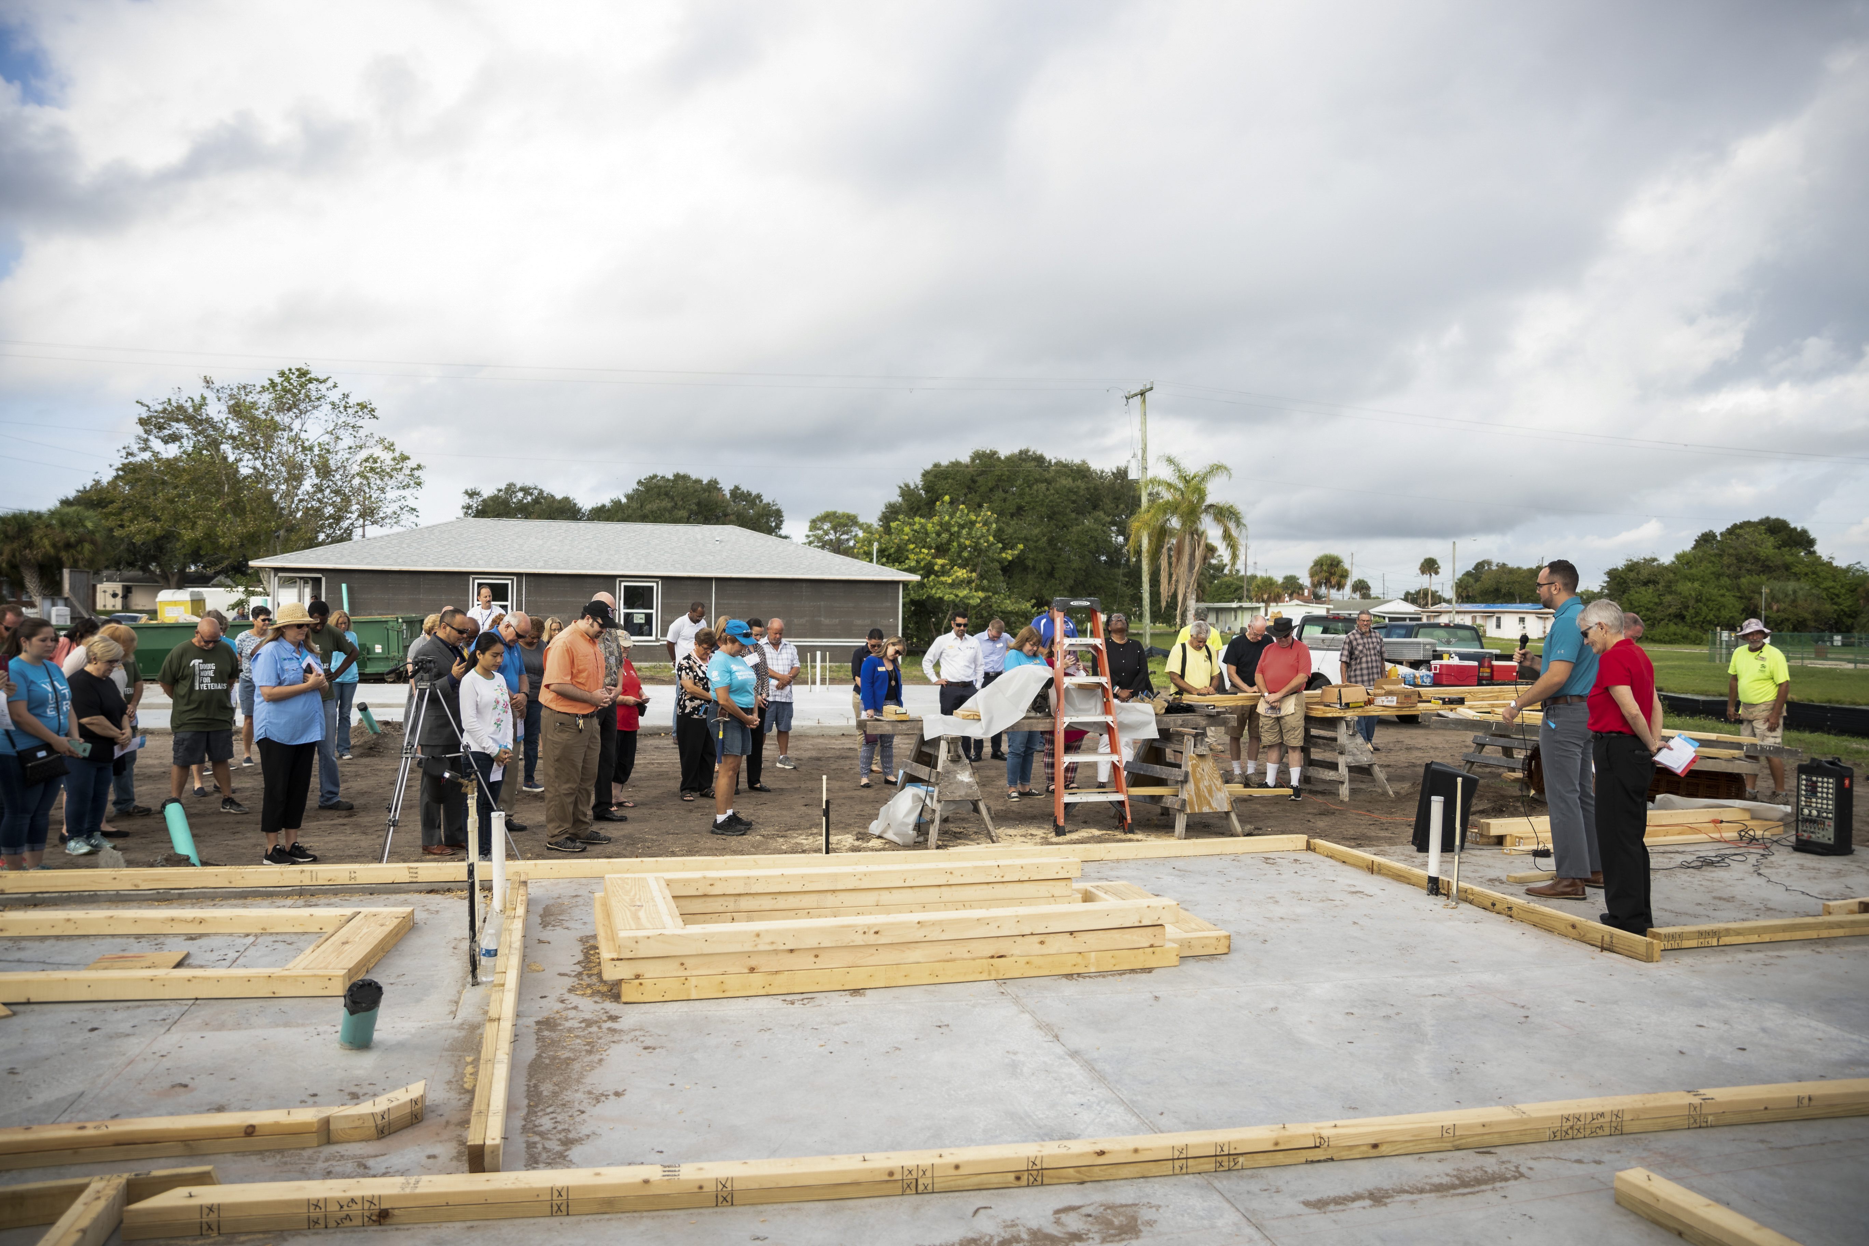
On Site
Begins with:
  Sign in & waivers
  Introductions
  PRAYER
Followed by:
  Overview of the day’s tasks
    Communicate expectations and hopes
    Ask if anyone is unable to do certain tasks

Slide 9
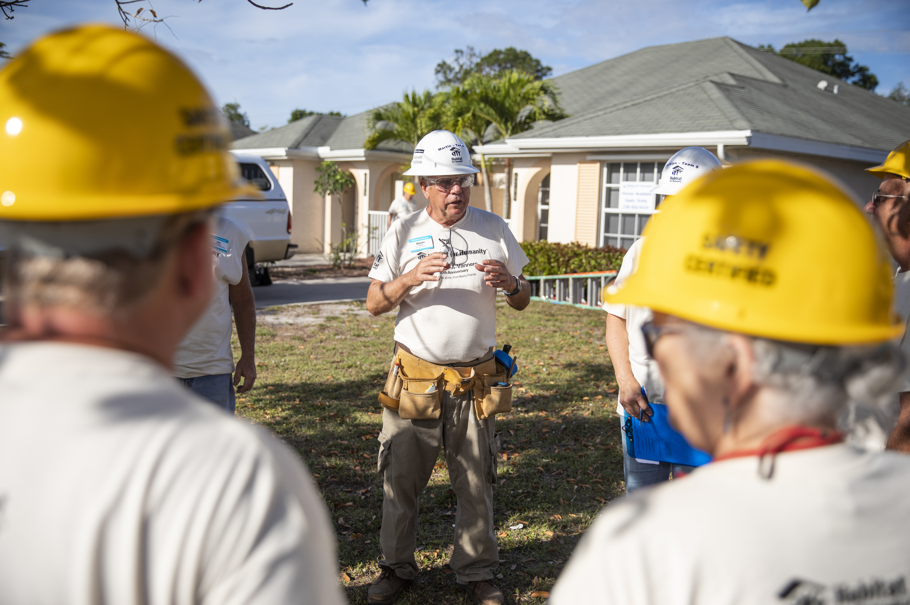
Safety
General Safety Talk
  Site Safety
  Everyone is responsible for safety
Break into groups
Task Specific Safety Talk
  Ladders
  Lifting etc.

Slide 10

Then

Slide 11
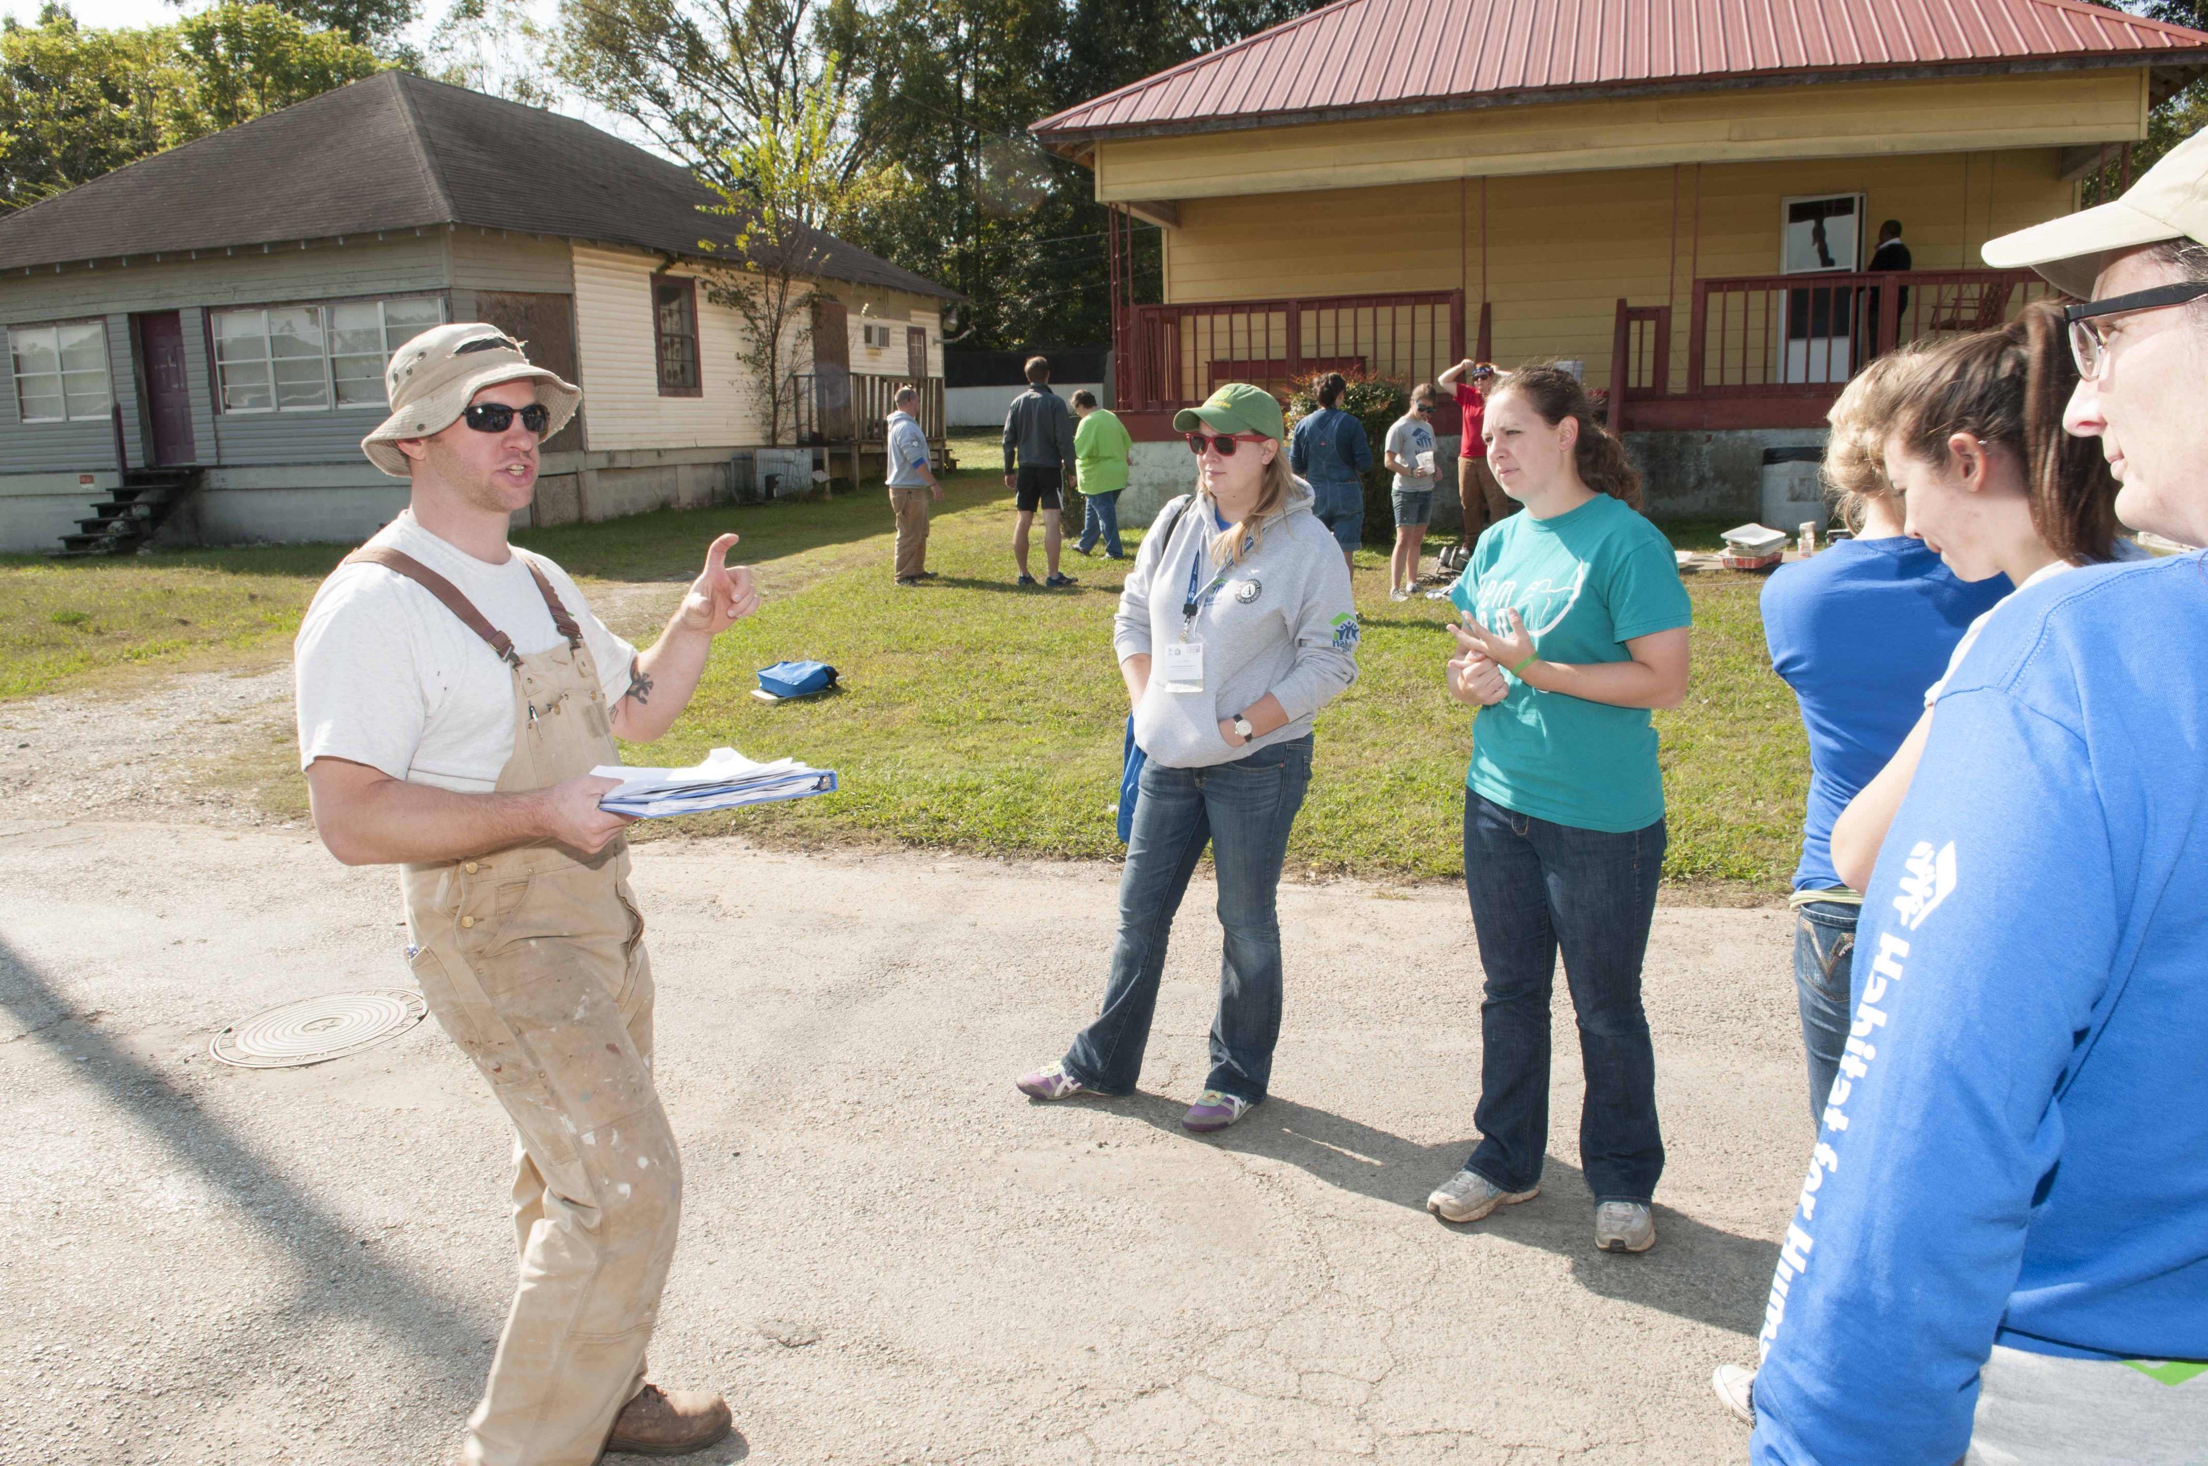
LEAD
Teach
  Tell
  Show
  Watch them do it
Advocate
  Mission
Cultivate
  Leaders and Donors

Slide 12
Volunteers have needs
Strong Leadership
Positive Experience
  Make it fun
Meaningful Tasks
  Even sweeping can be meaningful when properly presented
Clear Goals
Inclusion

Slide 13
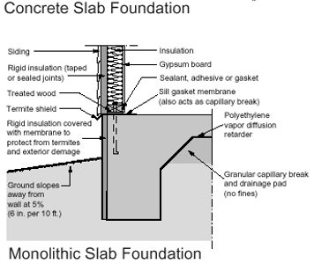
We meet the needs by:
Structure
  Share the schedule
    Have a list of tasks for the day on site
  Checklists
  Job descriptions
Empowerment
  Share the blueprints
  Share details
  Encourage them to learn

Slide 14
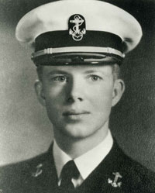
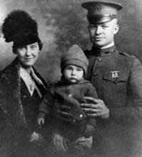
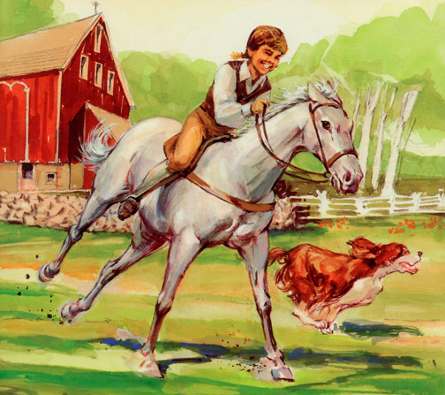
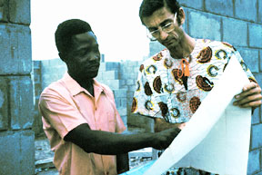
Find Leaders

Slide 15
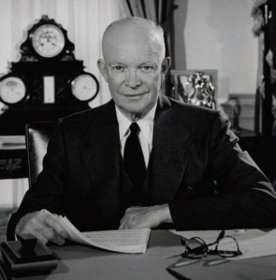
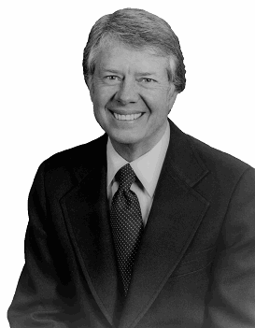
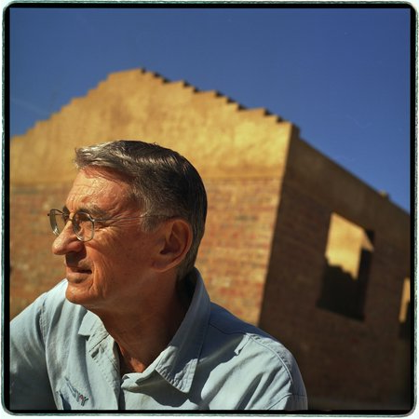
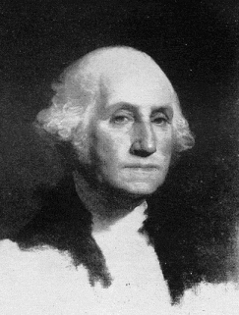
Like These

Slide 16
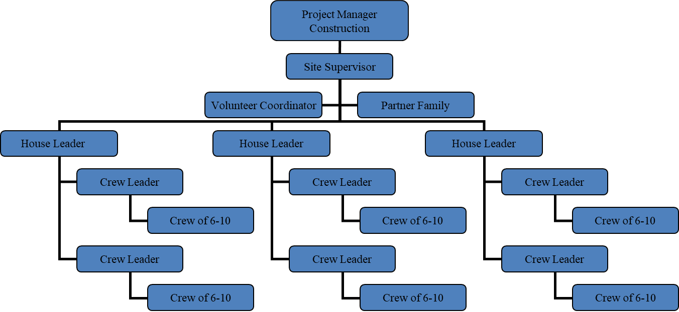
Structure

Slide 17
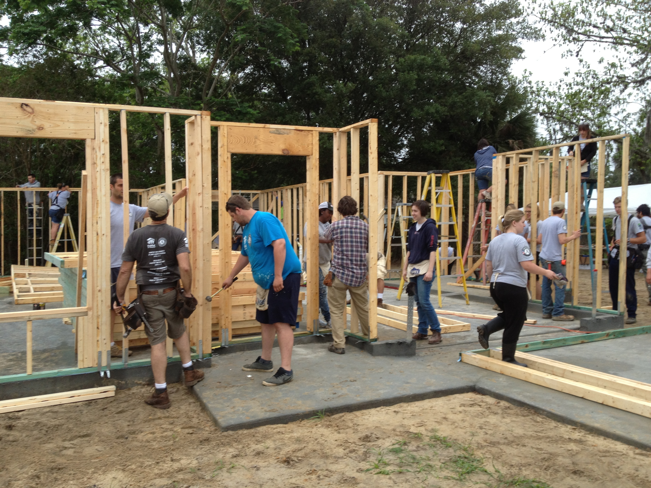
How do we do this?
Identify
  What do we look for?
Recruit
  How do we ask?
Train
Retain
Reward

Slide 18
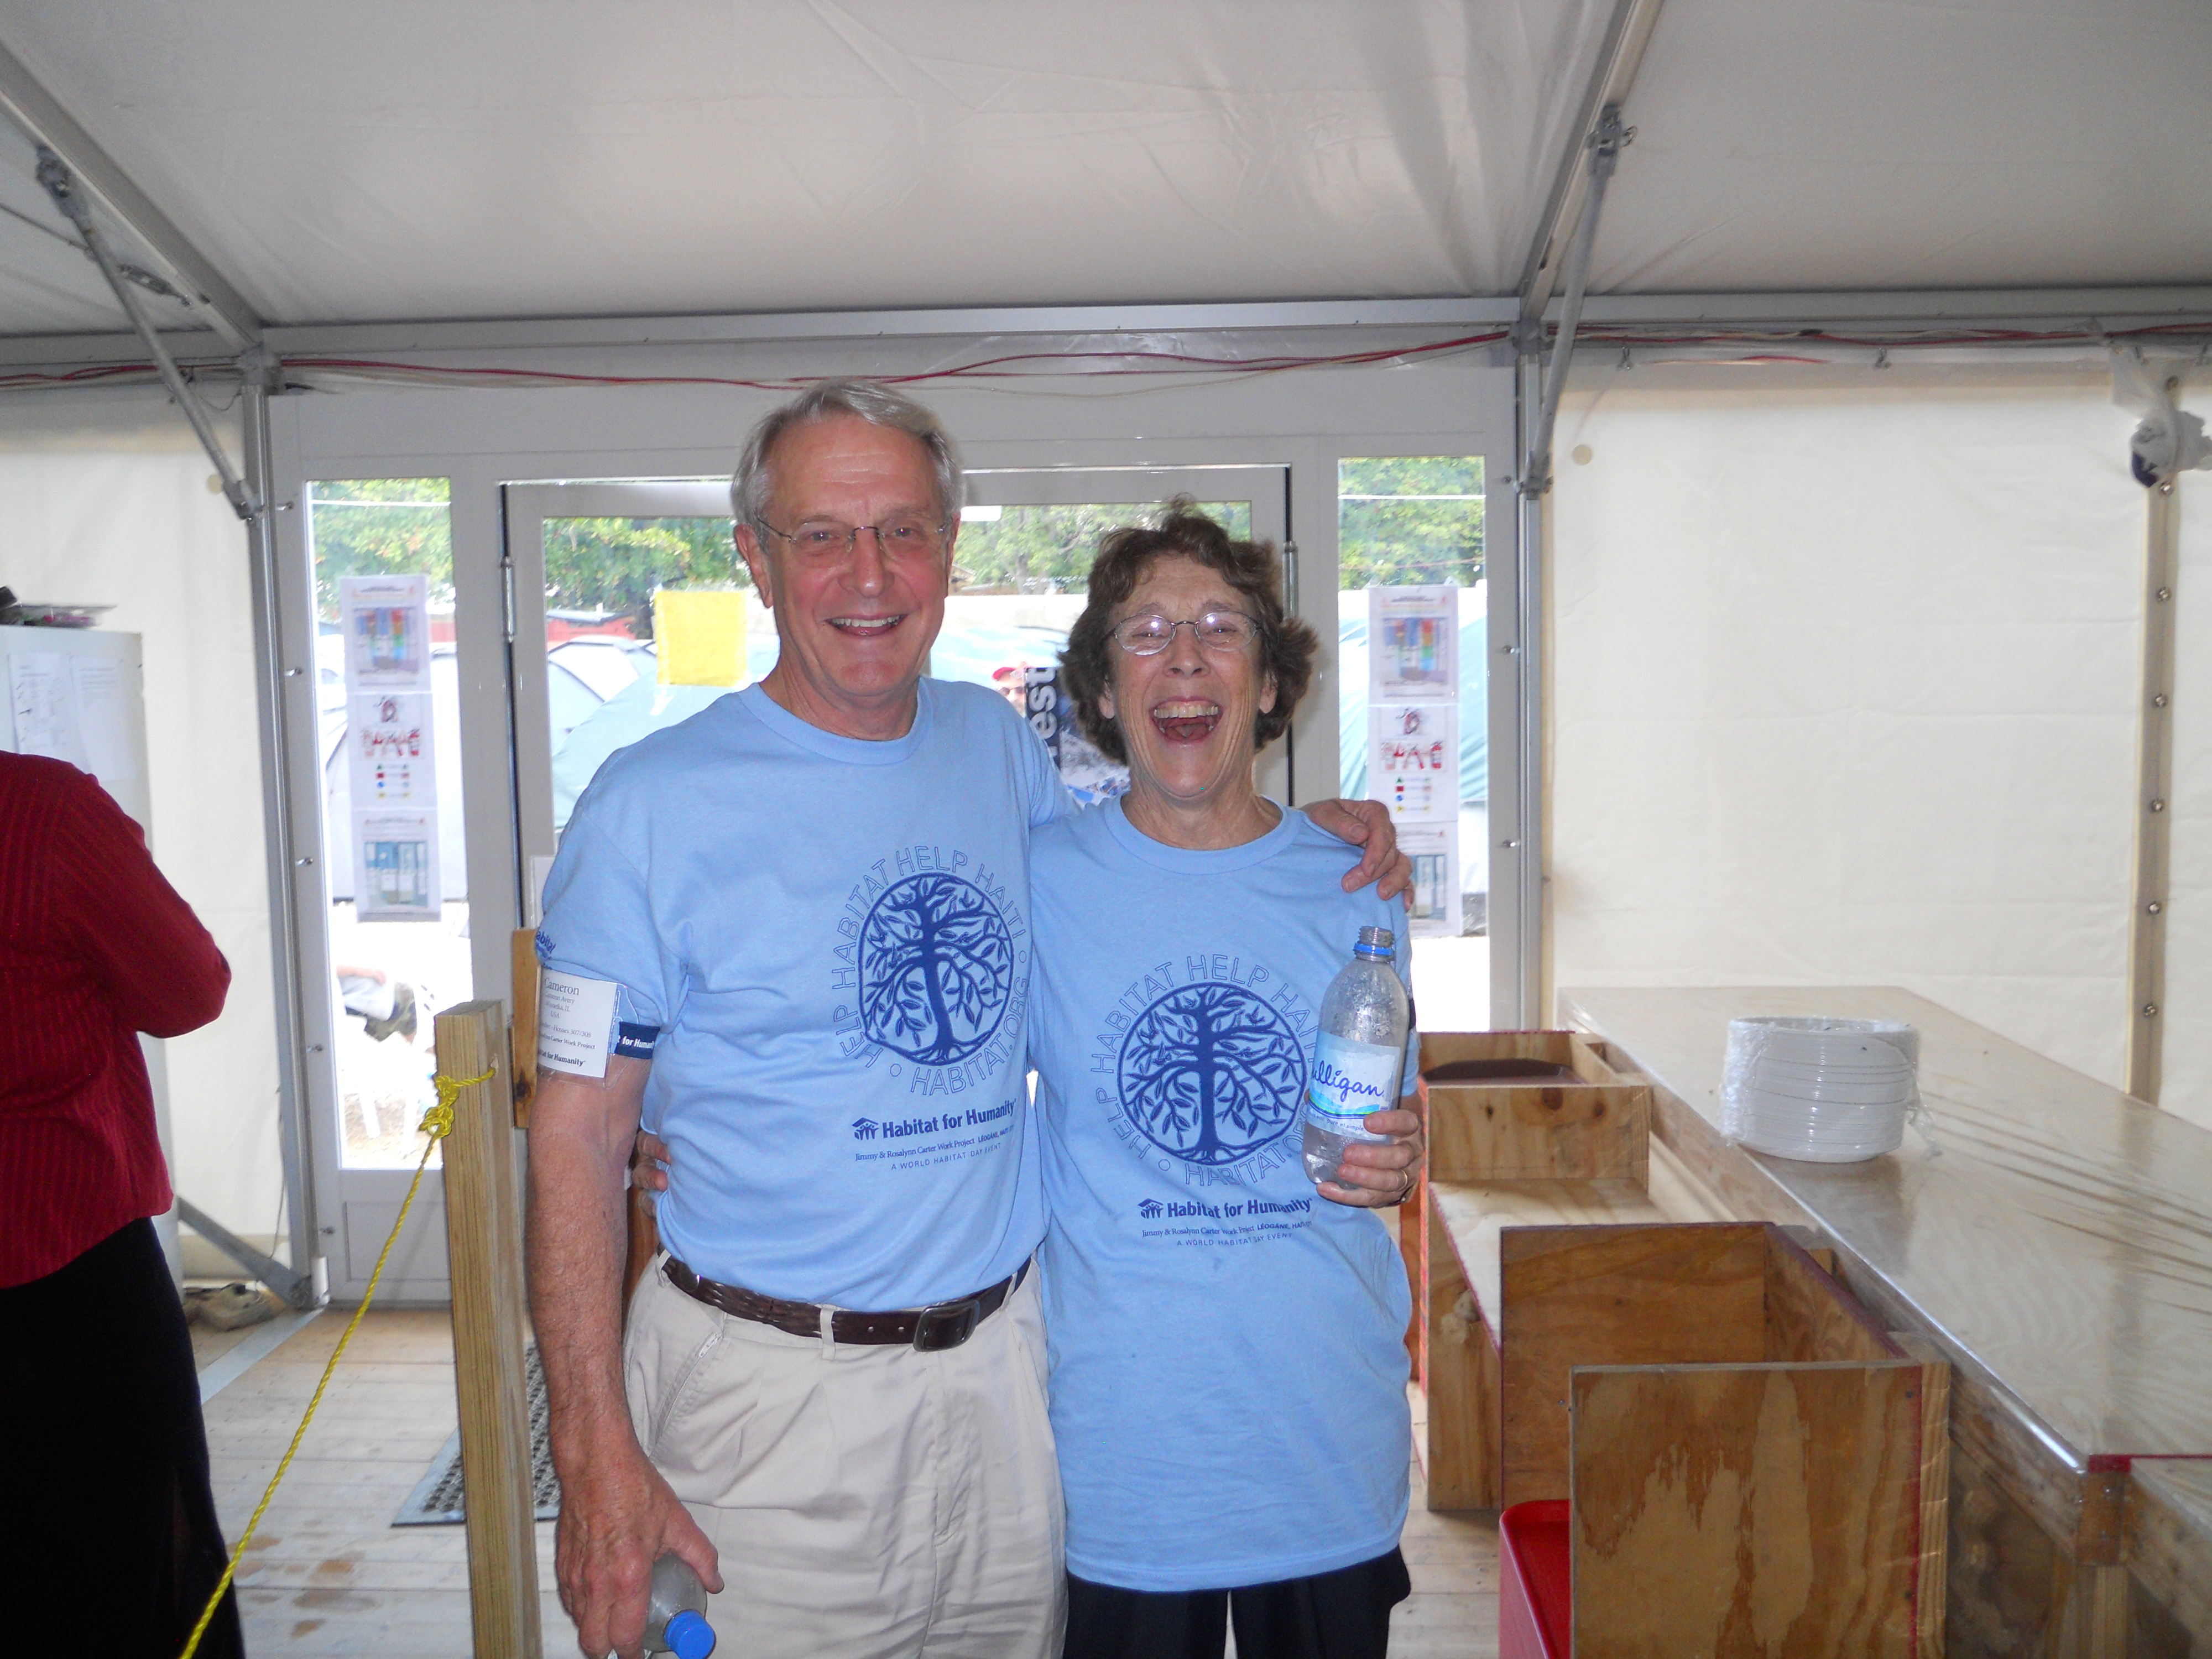
Look for
People Skills!!!!!!!!!!!!!
Good Leaders –
  Have high energy
  Are organized
  Inspire confidence in others
  Make good decisions
  Are prepared
  Are able to delegate

Slide 19
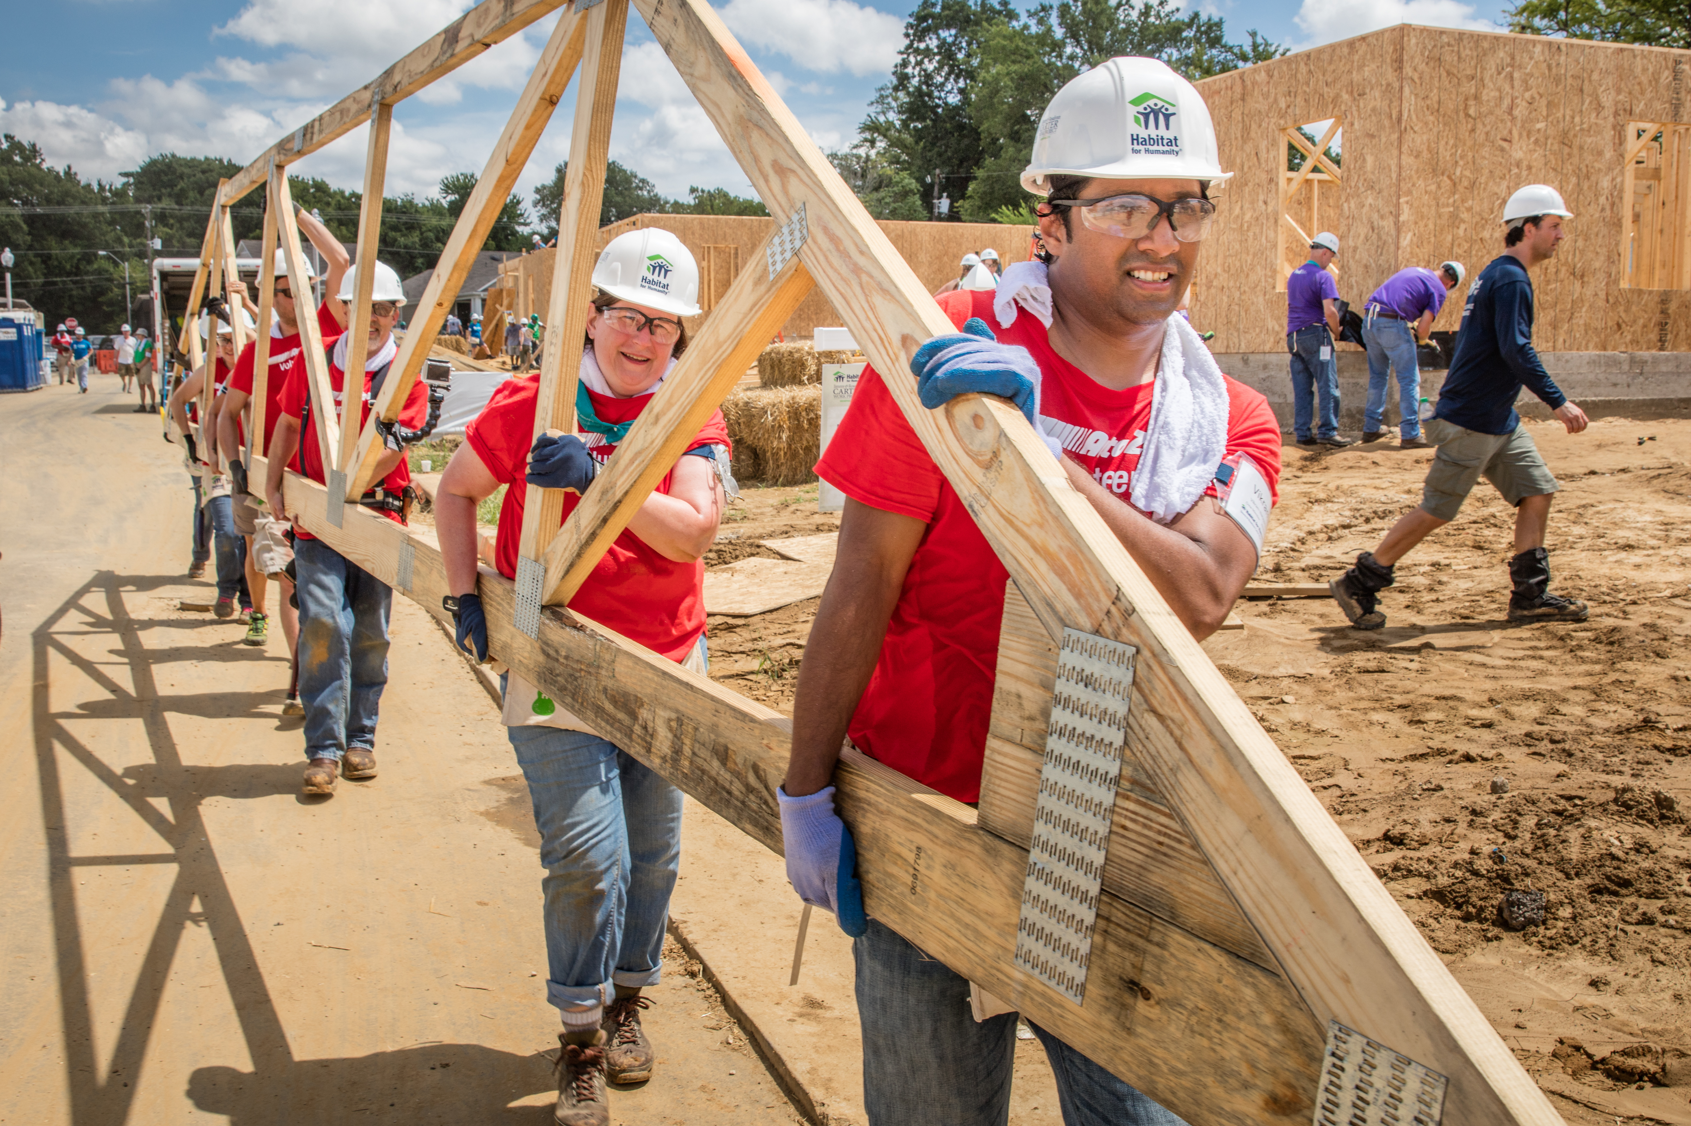
Good Leaders
Are trained to know how to do a task
Can convey that knowledge to others
  Clear & Concise
Can identify individual and group skill levels
Encourage volunteers
Are prepared
Make it fun

Slide 20
Training
General Habitat Leadership
  Habitat 101
  Volunteer Mgmt.
  Safety
  Quality
Task Specific (Crew Leader)
  Framing
  Windows
  Drywall

Slide 21
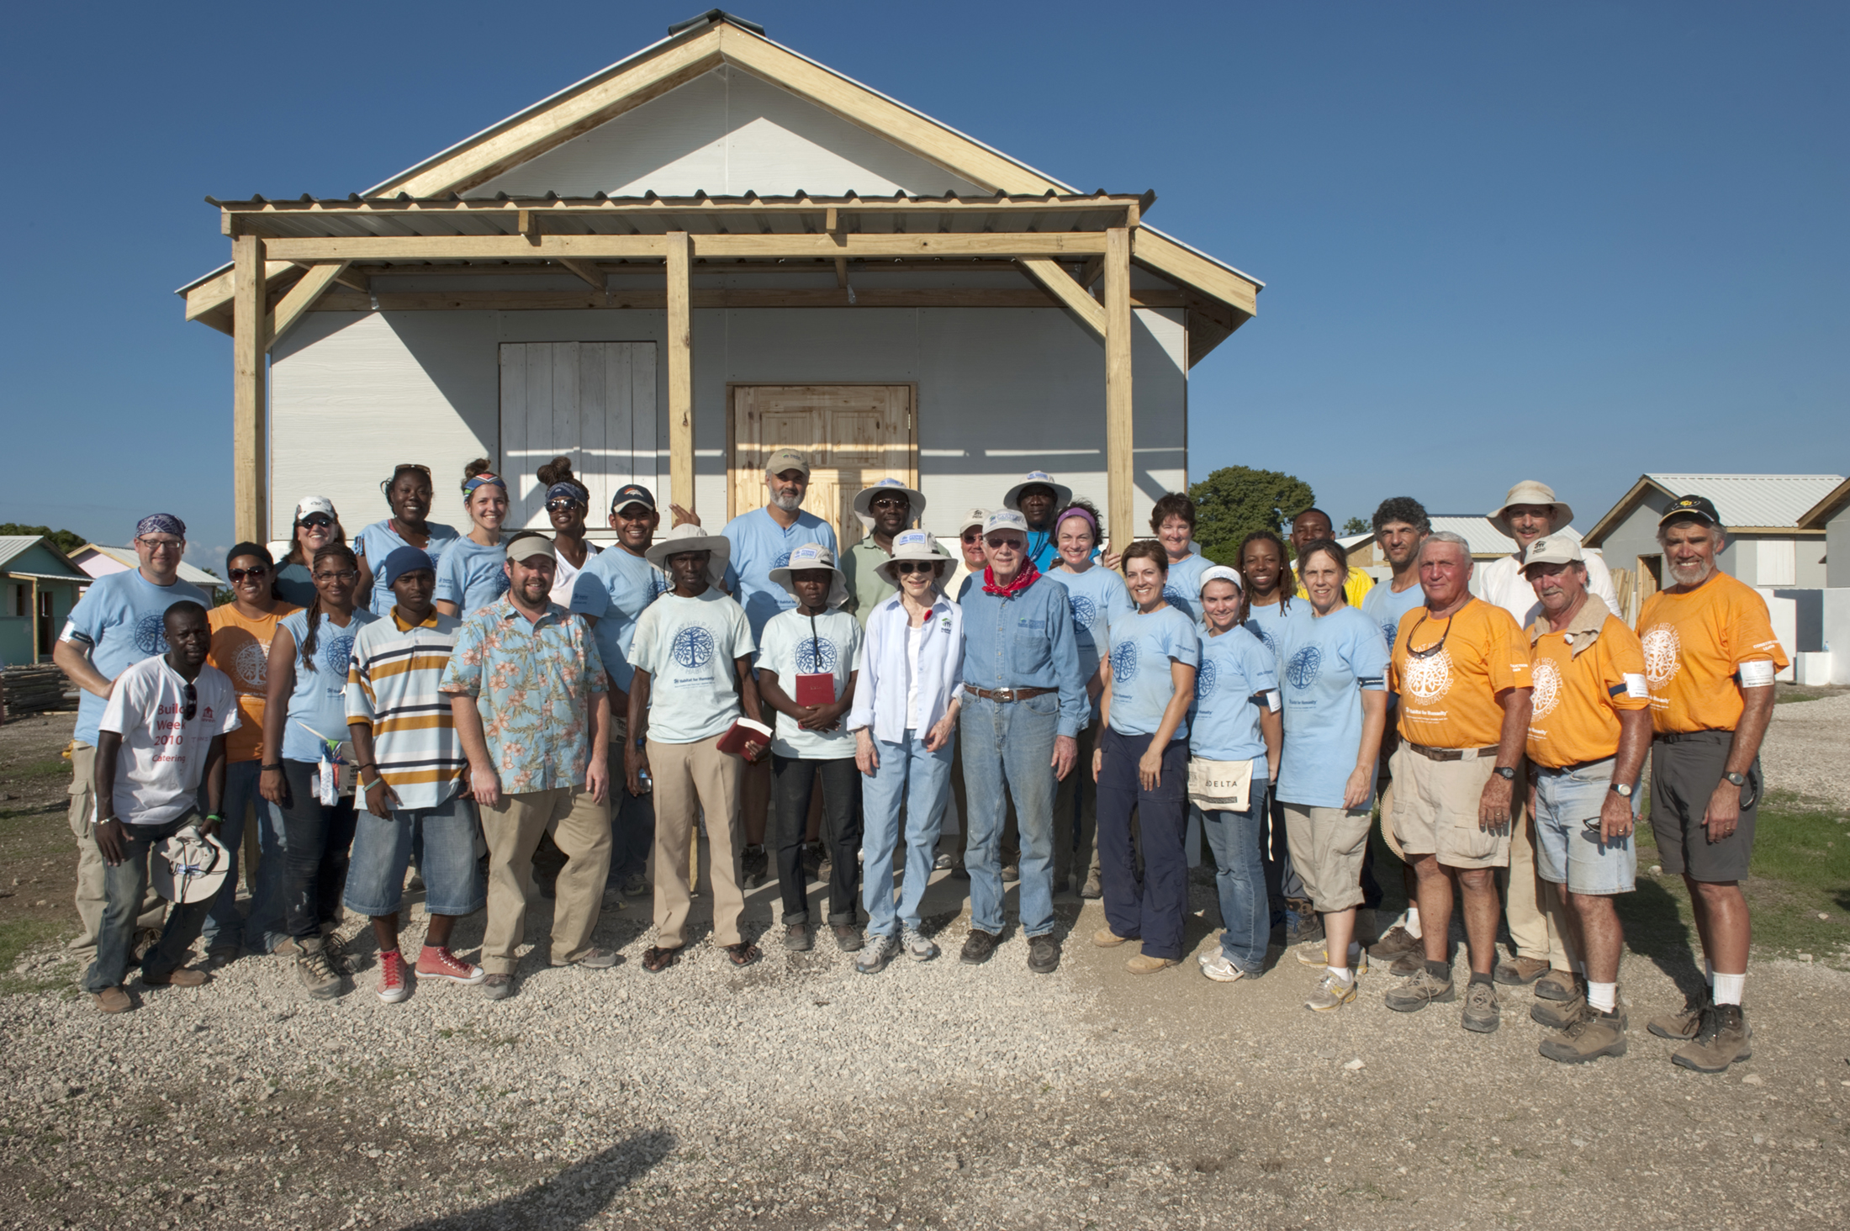
Empower & Recognize
Certificate
Group get-togethers
Special hat or t-shirt
Awards for achievements

Slide 22
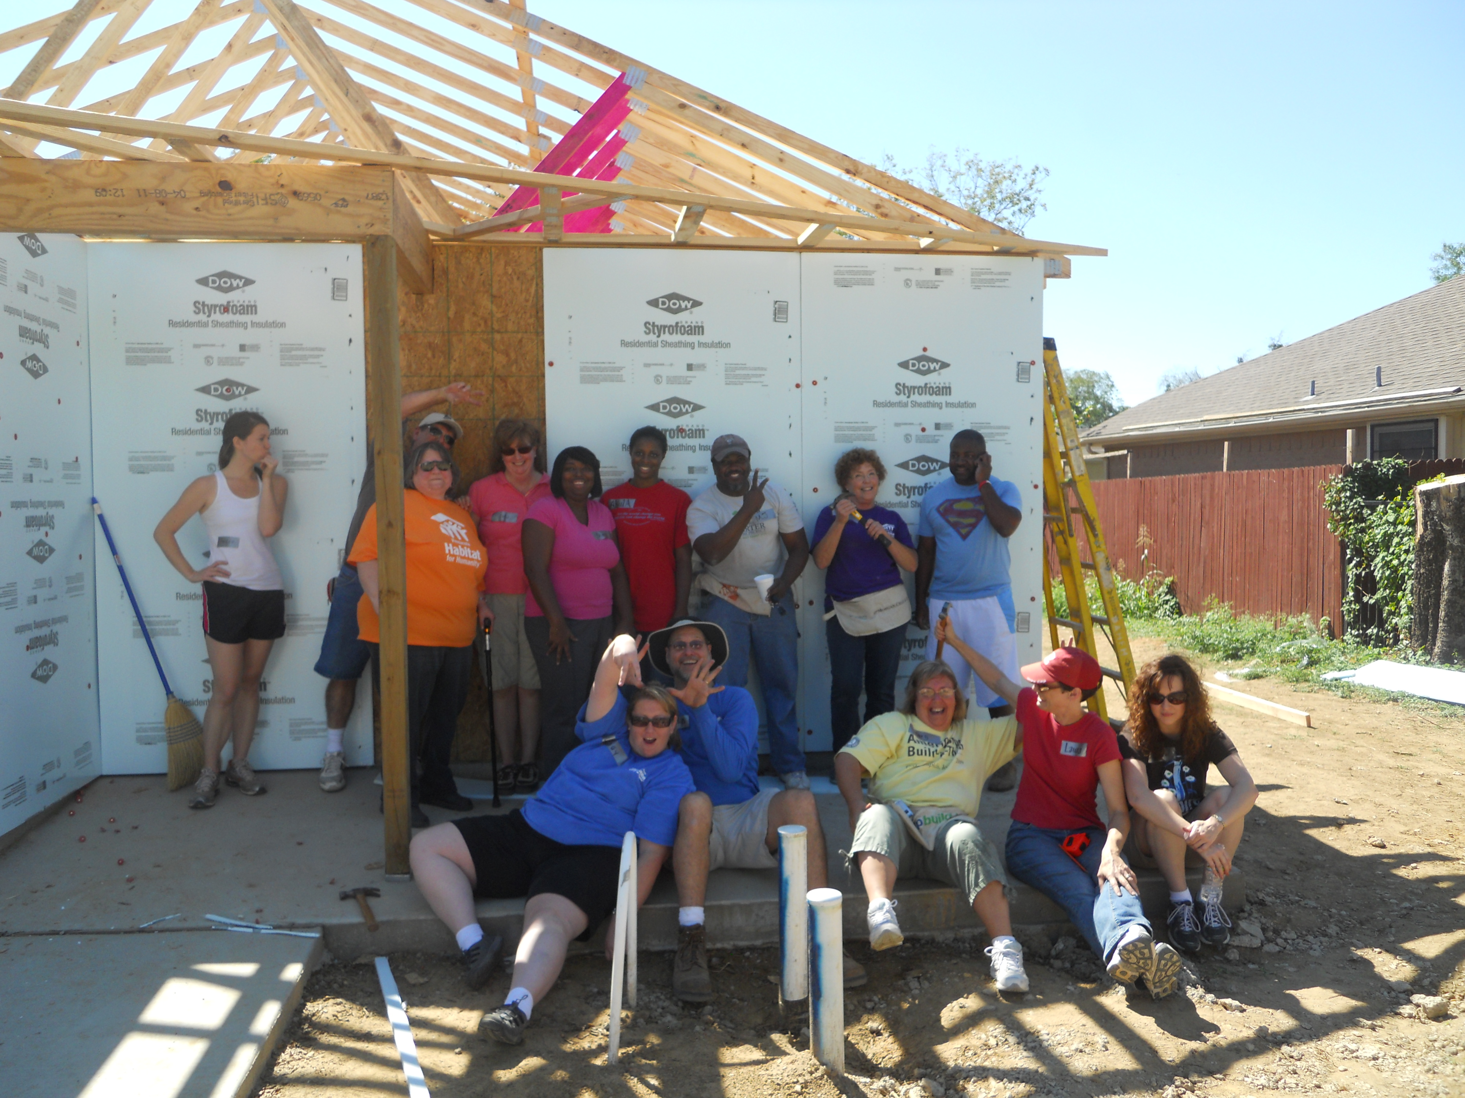
Best Practices

Slide 23
Volunteers
Always thank volunteers as they leave
Try to keep communication after they volunteer
  Weekly emails showing progress
Have yearly volunteer appreciation events
Make them advocates for affordable housing

Slide 24
Potential Leaders
Use Structure
  Schedules
  Checklists
  Budgets
Spend the time to help them develop
Preach the mission and Vision of Habitat

Slide 25
Resources
Volunteer Management Basics Certificate Training (VMCT)
Volunteer Management Job Descriptions
Motivating and Recognizing Volunteers
All these are on the new My.Habitat

Slide 26
Questions?
Mike Welch – miwelch@habitat.org

