Slide 1
Building
a brighter
Future
for our work together
Understanding
the Collaborative Operating Model

Slide 2
In the future state,
Habitat for Humanity:
Marshals our collective power to partner with exponentially more people, in the U.S. and throughout the world to build strength, stability and self-reliance through affordable housing.
Seamlessly engages donors and volunteers as they contribute to the mission.
Is the most important voice for affordable housing.
Is a federation of highly-efficient and successful organizations with clarified roles for local, state and national entities.

Slide 3
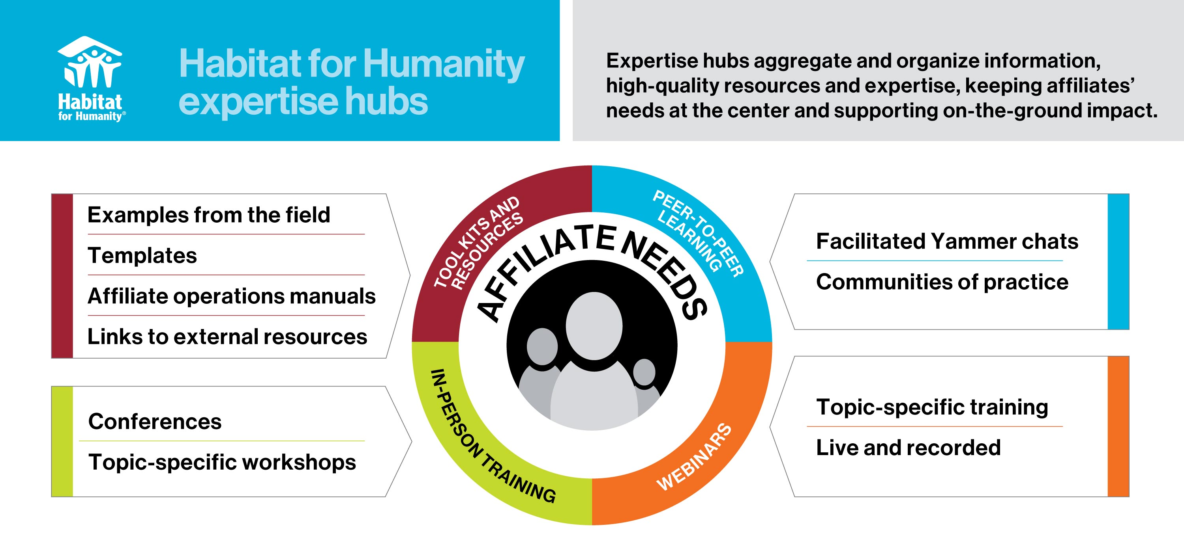
Resource Development: Fundraising Planning
Management & Operations: Board Management & Financial Management

Slide 4
FY20 Product/Service Overview
Q1
Q2
Q3
Q4
Toolkits/
Resources
Virtual Trainings: Webinars, Yammer events & Podcasts
Communities of Practice
In-person Trainings
Resource Development
Management & Operations

Slide 5
External Experts
Habitat International Experts
Affiliate/SSO Experts
Resource Development
Management & Operations

Slide 6
Cost of Home
5 year campaign goal:
10 million people with increased home affordability, including substantial increases in low-income homeownership opportunities, through policy and systems change at the local, state and national levels.
The Cost of Home campaign aims to improve housing affordability by influencing policies and systems focused on:
Supply and preservation
Land use
Access to credit
Communities of Opportunity

Slide 7
Improving the affiliate experience
Issue:
9, 12, 6
Up to nine HFHI departments ask for the same 12 documents annually via six different mechanisms

Slide 8
Improving the affiliate experience
Issue:
9, 12, 6
Up to nine HFHI departments ask for the same 12 documents annually via six different mechanisms
Solution:

Slide 9
Direct Marketing Pilots
Deliver a donor-centric experience
Reduce competition between affiliates and HFHI
Raise more money

Slide 10
Direct Marketing Pilots
Deliver a donor-centric experience
Reduce competition between affiliates and HFHI
Raise more money
Habitat for Humanity of Charlotte
Habitat for Humanity Chicago
Chicagoland Habitat for Humanity
Habitat for Humanity of Greater Cincinnati
Habitat for Humanity East Bay/ Silicon Valley
DuPage Habitat for Humanity
Flower City Habitat for Humanity
Fox Valley Habitat for Humanity
Habitat for Humanity of Greater Indianapolis
Habitat for Humanity of Jacksonville, Inc.
Habitat for Humanity Lake County, Illinois
Habitat for Humanity of Greater Los Angeles
Habitat for Humanity of McHenry County
Habitat for Humanity of Northern Fox Valley
Habitat for Humanity Portland/Metro East
Will County Habitat for Humanity

Slide 11
Revenue Share Distribution
HFHI Only Donors
Shared/New Donors
Affiliate Only Donors
Donors that appear on both HFHI and pilot affiliate database
New donors acquired through pilot efforts
Existing HFHI only donors in GSAs of pilot affiliates
Existing affiliate only donors in affiliate GSA
HFHI receives 100% of the revenue
Revenue is spilt 50/50 50% goes to HFHI 50% goes to Affiliate
Affiliate receives 100% of the revenue

Slide 13
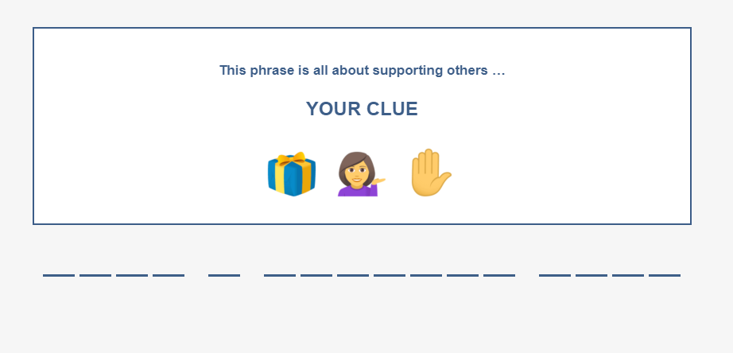

Slide 14
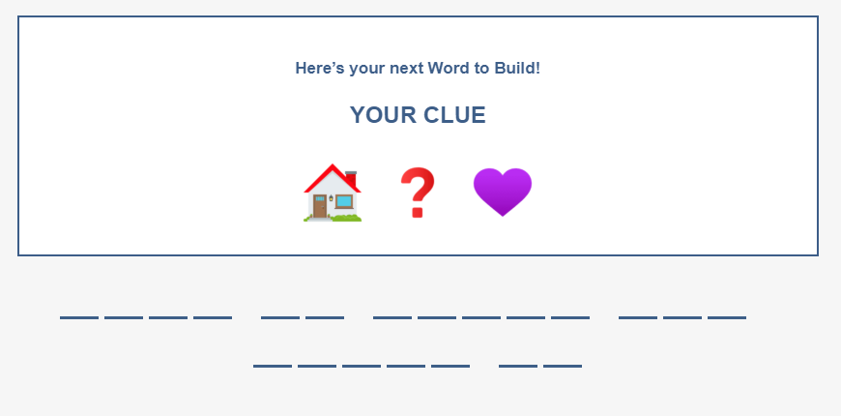

Slide 16
Habitat 2.0
US Affiliates
HFHI
International
HFHI revenue
HFHI operating expenses
US Supports
~ $50M
Activities with US Affiliates as primary customer(s)
“Strong Federation”
~ $38M
Activities that HFHI must do, regardless of # affiliated entities
International Supports
~ $47M
Activities with international stakeholders as primary customer(s)
Challenge:
Create a fundraising environment that significantly increases potential to raise more dollars, reduces donor confusion and eliminates fundraising competition and tension between affiliates and HFHI
Challenge: Under a more collaborative operating model—where some/all funds raised by HFHI are distributed to Affiliates–HFHI must have a way to fund operating expenses
Challenge: The global ministry—primarily funded by US donors and Affiliates—requires a strong and sustainable funding source

Slide 17
Questions
MYHABITAT:
Search “Collaborative Operating Model”
EMAIL:
collaboration@habitat.org
Collaborative Operating Model
A better model.
A brighter future.

